Slide 1
Sample Instrumentation
Aidan Sensiba and Vincent Miller

Slide 2
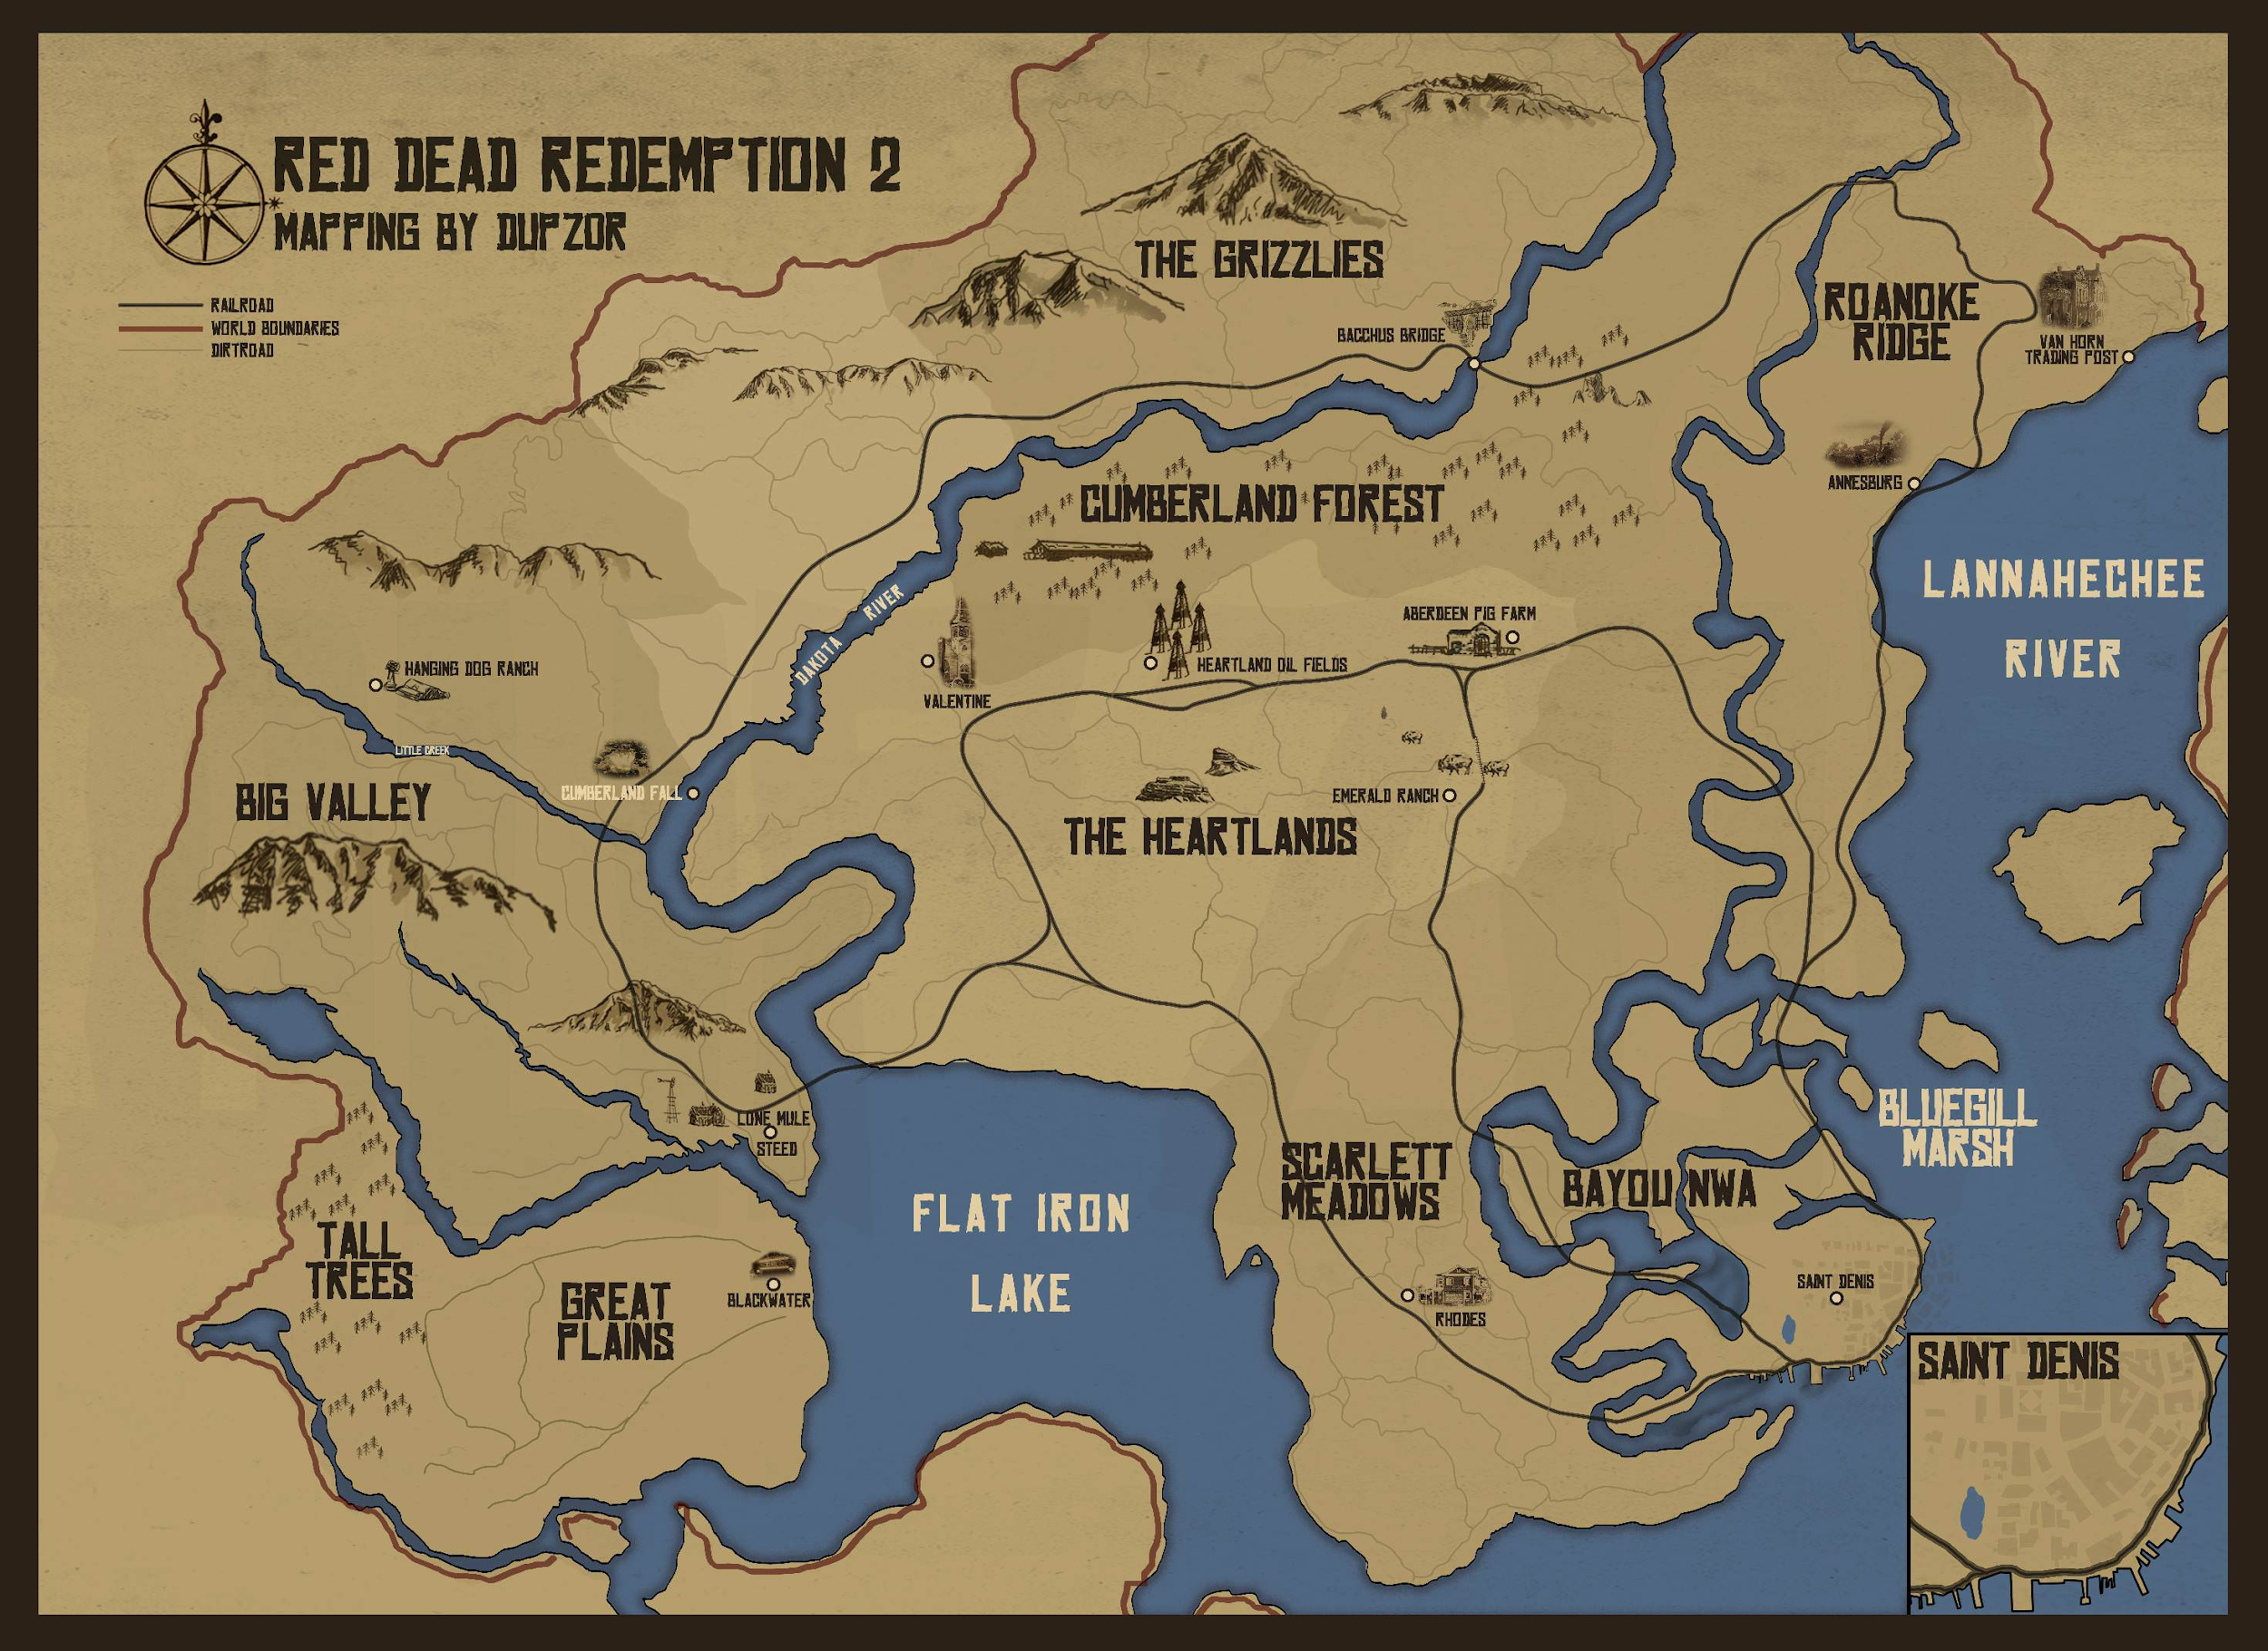
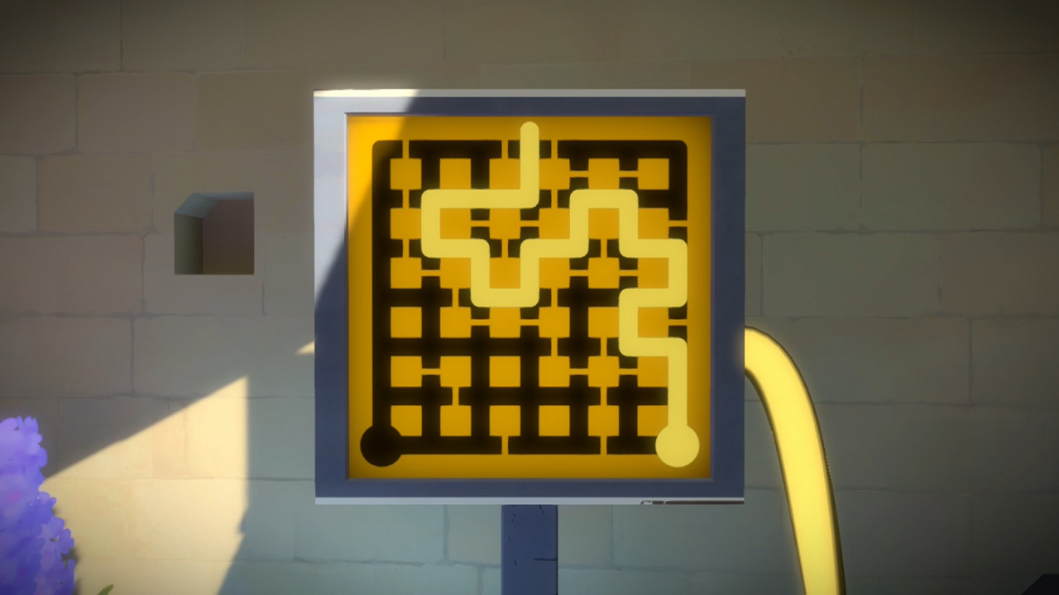
Experience Goals
Padding out gameplay:
Maximize the distance the player travels
More “challenging” puzzles:
Maximize time spent making decisions

Slide 3
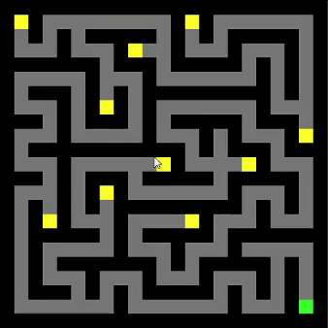
Strategy
Rotate view to prevent planning ahead

Slide 4
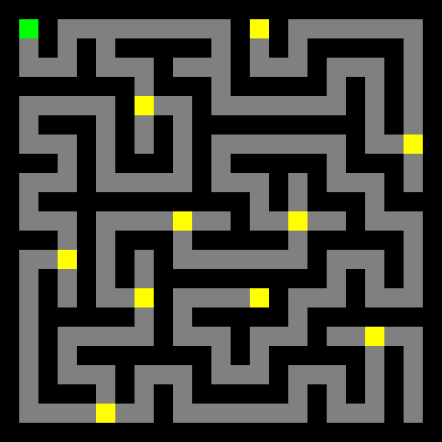
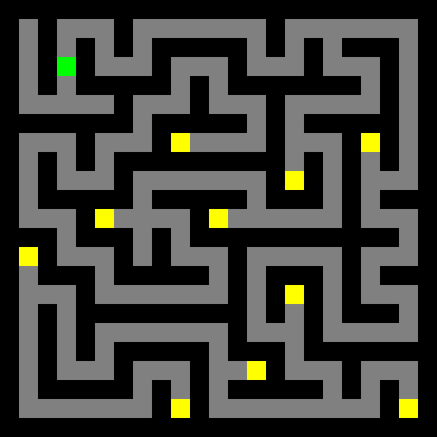
Strategy
Move gold to dead ends

Slide 5
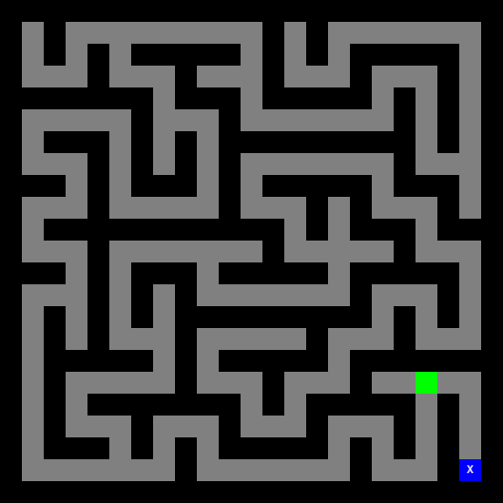
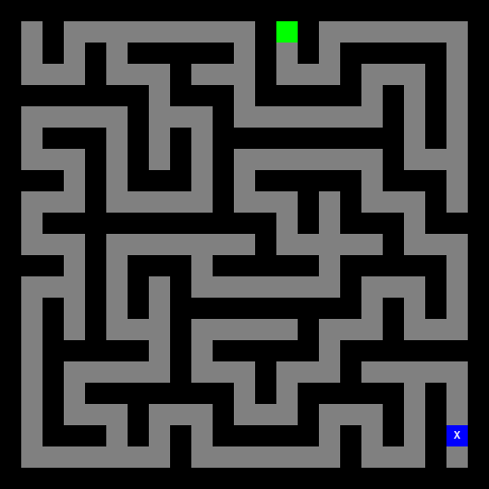
Strategy
Move end goal to be far from where player ends up

Slide 6
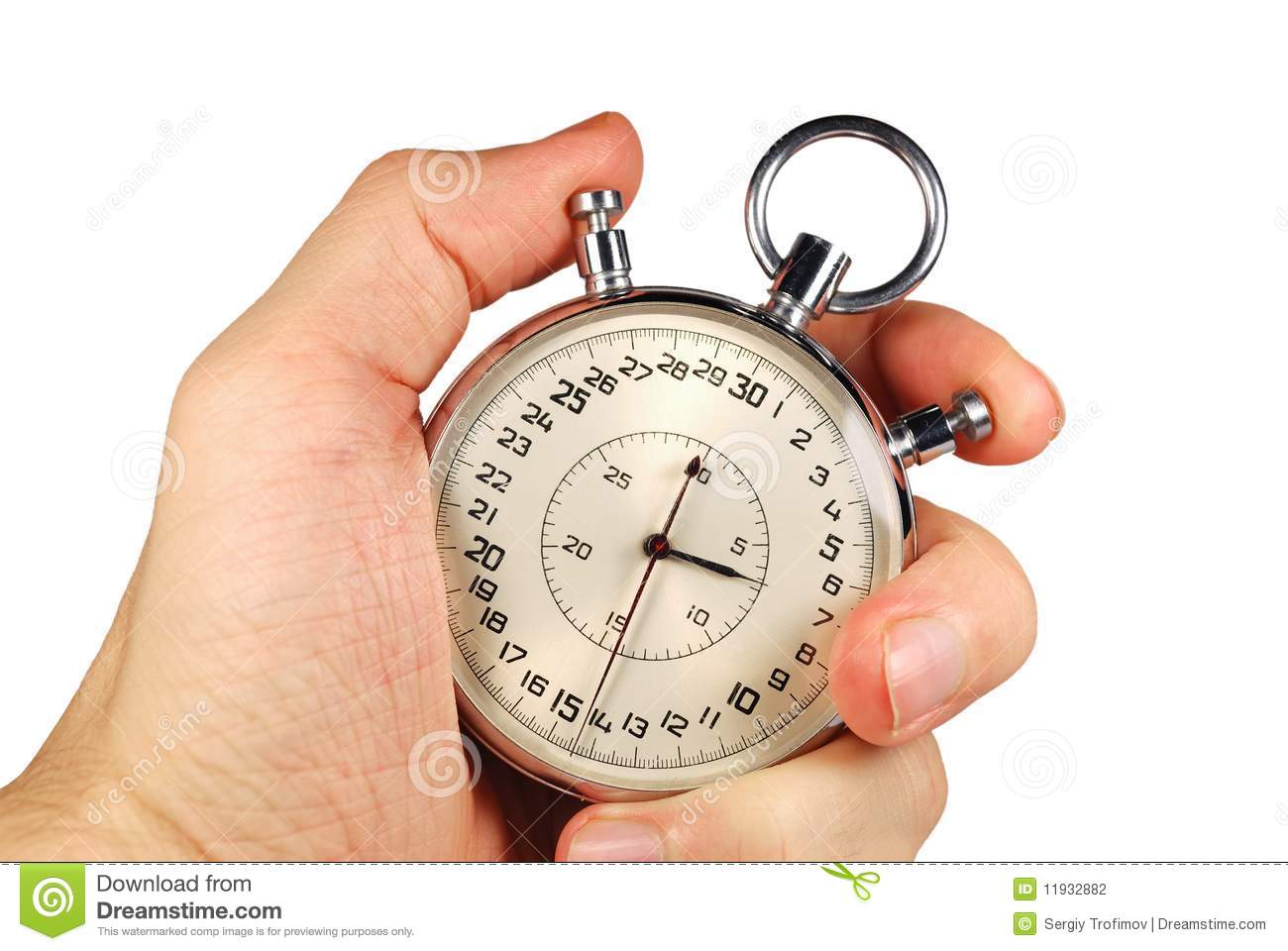
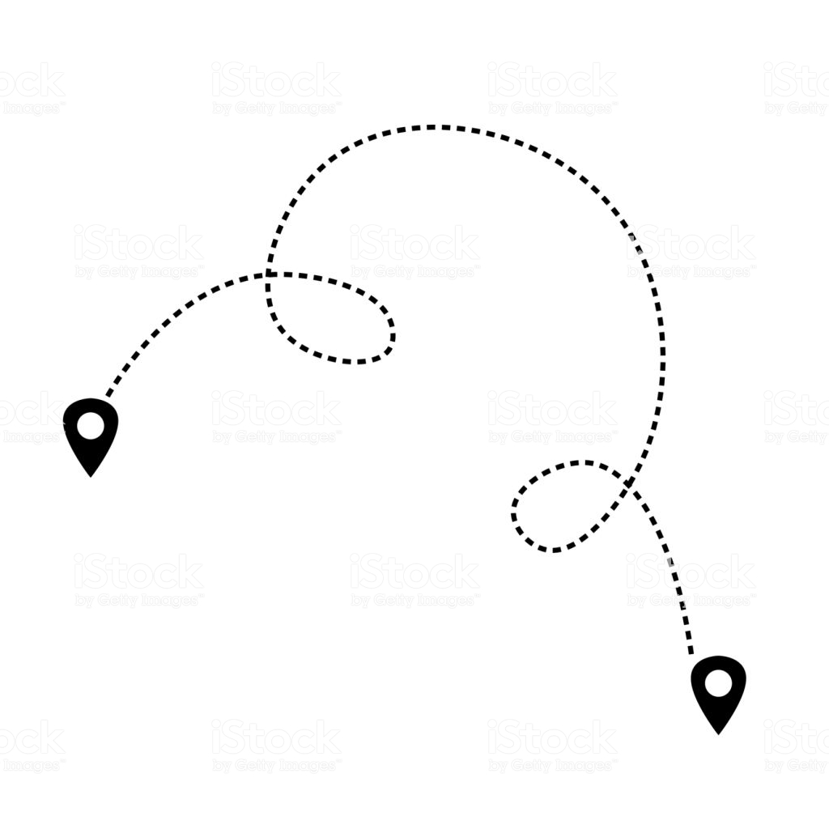
Metrics
Total game length in seconds
Average time between actor stopping and next click
Total distance travelled by the actor

Slide 7
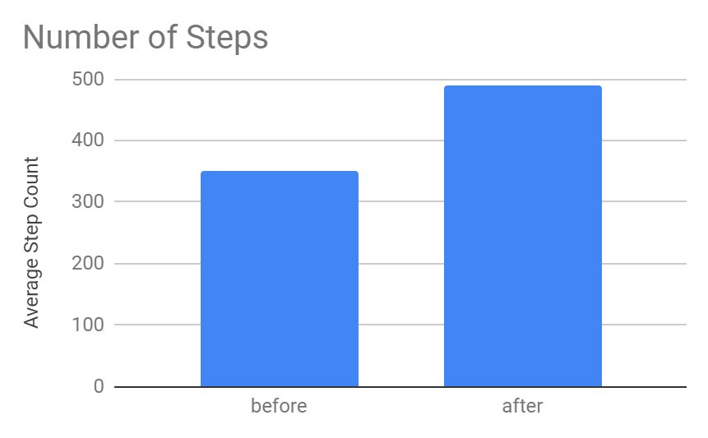

Slide 8
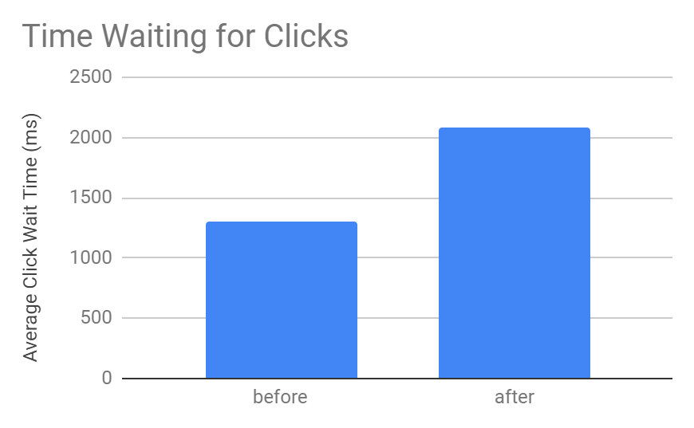

Slide 9
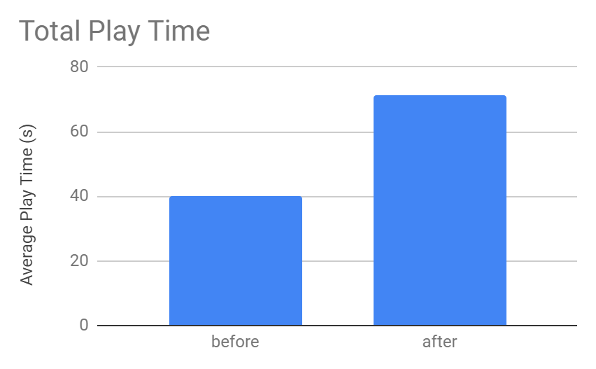

Slide 10
Links
Game: https://dgd-avclub.github.io/samplegame2/game.html

Slide 11
The End

